Slide 1

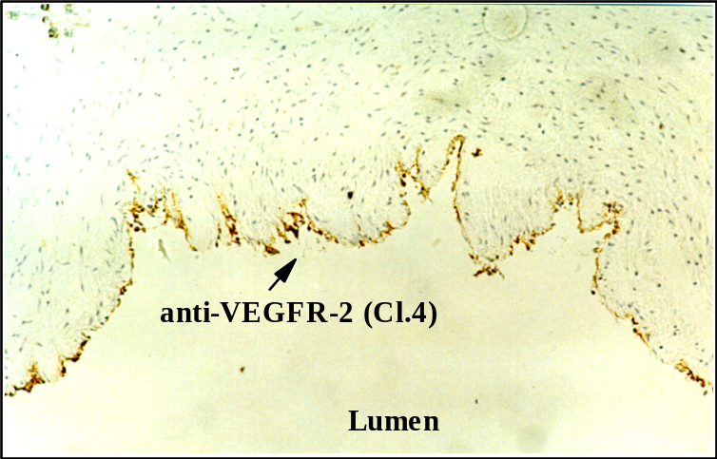
ReliaTech GmbH
Immunohistochemistry with a cryo section of a fresh human umbilical cord using
anti-human VEGFR-2 Clone 4
(#101-M34)
Fig. 1: Up-regulation of VEGFR-2 in vein ECs of an intact human umbilical cord by bFGF. A fresh human umbilical cord was rinsed with PBS to remove residual blood cells, cut in small pieces (about 0.5 cm), incubated in EBM (1% FCS) and stimulated with or without 20 ng/ml bFGF for 24 h. Pieces were frozen in liquid nitrogen and used for immunohistochemistry using the mab anti-human VEGFR-2/Cl.4 (#101-M34) as detection antibody.
(Bernhard Barleon et al., unpublished data!)
http://www.reliatech.de / orders@reliatech.de

